Slide 1
Creating a Java Main Class

Slide 2

Objectives
After completing this lesson, you should be able to:
  Create a Java class
  Write a main method
  Use System.out.println to write a String literal to system output
Notes:
Java SE 8 Fundamentals 3 - <number>

Slide 3
Topics
  Java classes and packages
  The main method
Notes:
Java SE 8 Fundamentals 3 - <number>

Slide 4

Java Classes
A Java class is the building block of a Java application.
Includes code that:
    Allows a customer to add items to the shopping cart
    Provides visual confirmation to the customer
ShoppingCart.java
Notes:
Java SE 8 Fundamentals 3 - <number>

Slide 5
Program Structure
  A class consists of:
    The class name. Class names begin with a capital letter.
    The body of the class surrounded with braces { }
      Data (called fields)
      Operations (called methods)
  Example:
  public class Hello {
  // fields of the class
  // methods
  }
Java is case-sensitive!
Notes:
A class is declared using the keyword, class, followed by the class name.
Convention dictates that the class name start with a capital letter. If there are two words in the class name (SayHello), each word should begin with a capital letter. In the example above, the class name is Hello.
The keyword public is called a modifier. You learn about these in the lesson titled “Using Encapsulation.”
Java is case-sensitive. It does not recognize the following two words as being the same thing: class and Class.
A class would typically contain data (called fields) and operations (called methods). You learn about this a little later.
Notice that the body of the Hello class is enclosed in braces ({ }).
Java SE 8 Fundamentals 3 - <number>

Slide 6
Java Packages
  A package provides a namespace for the class.
    This is a folder in which the class will be saved.
    The folder name (the package) is used to uniquely identify the class.
    Package names begin with a lowercase letter.
  Example:
    package greeting;
    public class Hello {
    // fields and methods here
    }
Package name
The class’s unique name is: greeting.Hello
Notes:
The use of a package when you create a Java class is not mandatory, but it is strongly recommended. Notice the semicolon after package greeting;
Semicolons are required at the end of each statement. It is similar to the period at the end of a sentence. The sentence may wrap to another line, but it is not complete until the period. The Java compiler interprets a statement as being complete when it encounters the semicolon.
Java SE 8 Fundamentals 3 - <number>

Slide 7
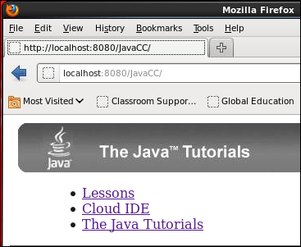
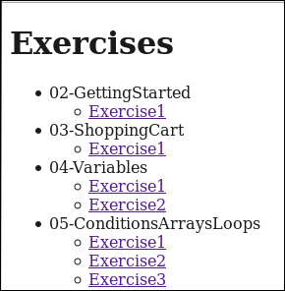
Using the Java Code Console
For the exercises in this course, you
use a browser-based Java IDE.
  Open a browser and
  enter: http://localhost:8080/JavaCC
  Click the Lessons link.
  Click the exercise number
  for the current lesson.
Notes:
IDE stands for Integrated Development Environment. This is a type of software that makes it easier to develop applications. In the practices for the lesson titled “Describing Objects and Classes” and beyond, you use the NetBeans IDE, which is a full-featured Java IDE.
For the short exercises that are sprinkled throughout the lecture portions of this course, you will use a simple web-based IDE called Java Code Console. It was written specifically for this purpose. This IDE is hosted on your student machine.
Java SE 8 Fundamentals 3 - <number>

Slide 8
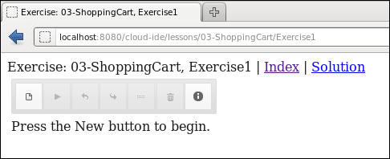
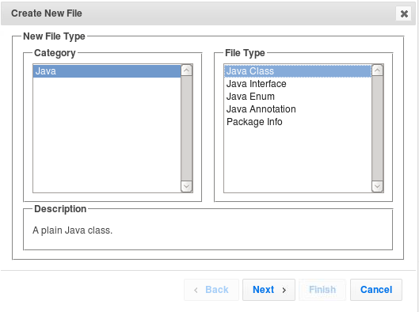
Using the Java Code Console:
Creating a New Java Class
  Click the New button to
  create a new file.
  Select the Java category
  and Java Class file type.
  Click Next.
Notes:
Most of the exercises provide a pre-existing Java class or classes, to which you add code. If the exercise you selected has a pre-existing .java file for you, it will appear in a tabbed view on this page.
In some cases, however, you need to create a new Java class. The steps are described here and in the next slide.
Click the New button as shown in the top screenshot.
The Create New File Wizard opens. Select Java in the Category column. Select Java Class in the File Type column.
Click Next.
Instructions are also displayed on the Java Code Console page, just below the code editor panel. However, if no Java file is provided and you are going to create a new one, the code editor is not shown. Therefore, the instructions appear just below the toolbar.
Java SE 8 Fundamentals 3 - <number>

Slide 9
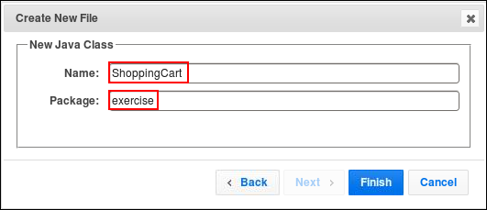
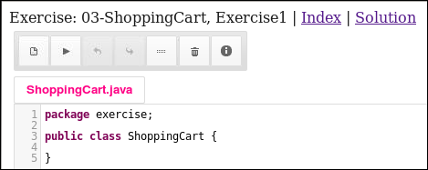
Using the Java Code Console:
Creating a New Java Class for an Exercise
  Enter a class name and a package name.
  Click Finish.
Run code
Show solution
Code editor
Return to List of Lessons
Notes:
Enter a class name and package name, as specified in the exercise instructions. When you click Finish, the code for this class appears in a tabbed page, bearing the class name.
In the left screenshot, you see the ShoppingCart.java tab, containing the package statement and the class declaration. This is the code editor panel.
You will write your code between the braces.
To test your code, click the Run button as indicated above.
To return to the list of exercises, click the Index link.
To view the solution for the exercise, click the Solution link. It will replace the current .java file with the solution .java file in the same tab, but you will be able to toggle between your code and the solution.
Java SE 8 Fundamentals 3 - <number>

Slide 10
Exercise 3-1: Creating a Class
In this exercise, you use the Java Code Console to create a new Java Class.
  Click New to create a new class:
    Class name = ShoppingCart
    Package name = exercise
  Leave the tabbed view open in the browser because you will modify the code in the next exercise.
Notes:
The fully-qualified class name should be exercise.ShoppingCart. Do not click the Solution link until after exercise 3-2.
Java SE 8 Fundamentals 3 - <number>

Slide 11
Topics
  Java classes
  The main method
Notes:
Java SE 8 Fundamentals 3 - <number>

Slide 12
The main Method
  It is a special method that the JVM recognizes as the starting point for every Java program.
  The syntax is always the same:
    public static void main (String args[]) {
    // code goes here in the code block
    }
  It surrounds entire method body with braces { } .
Notes:
The main method is a special method that the Java Virtual Machine recognizes as the starting point for a Java program.
Any program that you want to run must have a public main method.
A class containing a main method is referred to as a “main class.”
Note: Brackets ([]) can be placed to the right of String or to the right of args, but the former is recommended:
(String[] args)
(String args[])
Java SE 8 Fundamentals 3 - <number>

Slide 13
A main Class Example
Class name
  public class Hello {
  public static void main (String[] args) {
  // Entry point to the program.
  // Write code here:
  System.out.println ("Hello World!");
  }
  }
Comments
Program output
main method
Notes:
Here you see a simple example of a class (Hello) that includes a main method. The main method writes a message to the console (“Hello World!”). This is called program output.
You can include comments that the compiler will ignore, by preceding the comment line with two forward slashes: //
Java SE 8 Fundamentals 3 - <number>

Slide 14
Output to the Console
  Syntax:
    System.out.println (<some string value>);
  Example:
    System.out.println ("This is my message.");
String literal
Notes:
Use the System.out.println method to print a message to the console. Use double quotation marks to enclose the text of the message (called a String literal).
Java SE 8 Fundamentals 3 - <number>

Slide 15
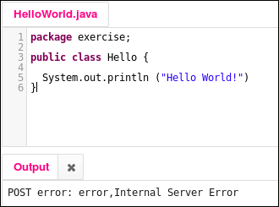
Fixing Syntax Errors
  If you have made a syntax error, the error message appears in the Output panel.
  Common errors:
    Unrecognized word (check for case-sensitivity error)
    Missing semicolon
    Missing close
    quotation mark
    Unmatched brace
Notes:
The Java Code Console helps you out by using color coding. Keywords (such as class) are in purple. String literals are shown in blue. When you click Run, it will attempt to compile your code and then run it. Syntax errors will be caught during compilation. The error message may or may not be helpful in troubleshooting, so here are some common errors to avoid:
Unrecognized class (It may say “Cannot find symbol.”). This happens when you misspell a method or class name, or if you get the case wrong. Remember, Java is case-sensitive!
Every Java statement must end with a semicolon. This example error is shown above in line 5.
An uneven number of symbols such as braces, brackets, and quotation marks will also cause errors.
Java SE 8 Fundamentals 3 - <number>

Slide 16

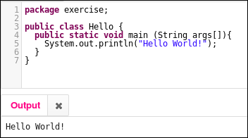
Exercise 3-2: Creating a main Method
In this practice, you manually enter a main method that prints a message to the console.
  In the code editor, add the main method structure to the ShoppingCart class.
  In the code block, use a System.out.println method to print “Welcome to the Shopping Cart!”
  Click the Run button to test program.
Example
Notes:
In the example above, you see a class called Hello. Within the braces that define the scope of the class, you see the main method. The method body is also surrounded by braces.
When you click the Run button as indicated in the image on the right, the program is both compiled (using javac) and executed (using java).
The println statement results in the “Hello World!” string appearing in the Output tab.
Java SE 8 Fundamentals 3 - <number>

Slide 17
Quiz
Which main method syntax is correct?
  Public static void main (String[ ] args){ }
  public Static void Main (String[ ] args){ }
  public static void main (String ( ) args)[ ]
  public static void main (String[ ] args){ }
Notes:
Answer: d
a is incorrect. It should be “public”, not “Public”.
b is incorrect. Both “Static” and “Main” should begin with a lowercase letter.
c is incorrect because there should be brackets following “String” and braces defining the method scope.
d is correct.
Java SE 8 Fundamentals 3 - <number>

Slide 18

Summary
In this lesson, you should have learned how to:
  Create a class using the Java Code Console
  Create (declare) a Java class
  Define a main method within a class
  Use System.out.println to write to the program output
  Run a program in the Java Code Console
Notes:
Java SE 8 Fundamentals 3 - <number>

